Slide 1
Reinforcement Learning Techniques
Ali Vaziri, Ph.D.,
Department of Mechanical Engineering
University of Kansas
June 2023
Supervisor: Dr. Huazhen Fang

Slide 2
Table of contents
Motivation
Markov Decision Process
Monte Carlo (MC) approximation
Monte Carlo for action values Q(s,a)
On-policy and off-policy learning
Temporal Difference (TD) learning
Advantages of TD learning
Simulation results

Slide 3
A quote by Arnold Schwarzenegger
“ I was poor, because I didn’t have anything. I had no money, no TV, no refrigerator, nothing as a kid, but I was reach because I had a dream. If you want to turn a vision into reality, you have to believe in your dream. ”

Slide 4
Motivation
In Dynamic Programming (DP), we are computing (planning), not learning!
Dynamic model is unknown.
We need direct learning methods!

Slide 5


Markov Decision Process
A Markov Decision Process (MDP) is a 4 tuple $\left(S,A, P, R\right)$ where:
Goal of RL:
States: 𝐬 ∈ 𝑺
Actions: 𝐚 ∈ 𝑨
Rewards: 𝐫 ∈ ℝ
Unknown model: 𝐏𝐫(𝒔’|𝒔, 𝒂)
Optimal Policy $π$that maximizes the expected future reward (cumulative reward)

Slide 6
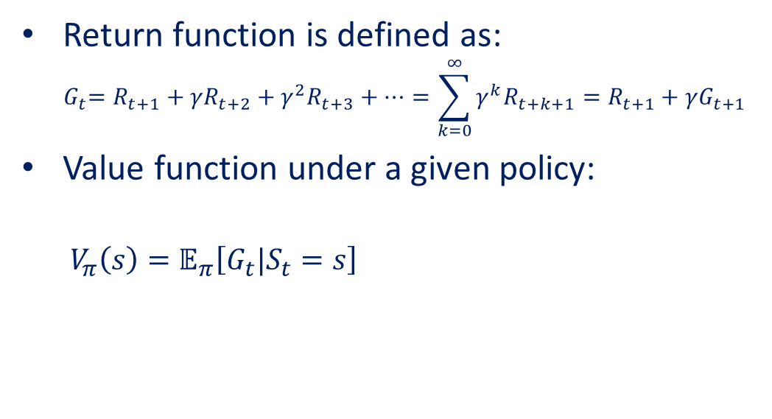
Monte Carlo approximation
Return function is defined as:
$${ G}_{t}=R_{t+1}+γR_{t+2}+γ^{2}R_{t+3}+…=\sum_{k=0}^{∞}{γ^{k}R_{t+k+1}}=R_{t+1}+γG_{t+1}$$
Value function under a given policy:
$V_{π}\left(s\right)=𝔼_{π}\left[G_{t}|S_{t}=s\right]$

Slide 7
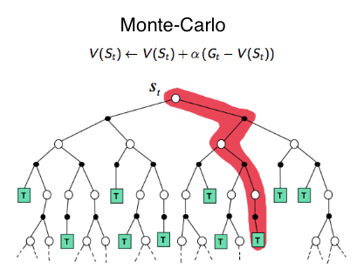
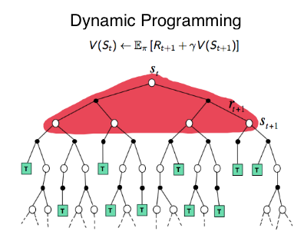
Monte Carlo approximation

Slide 8
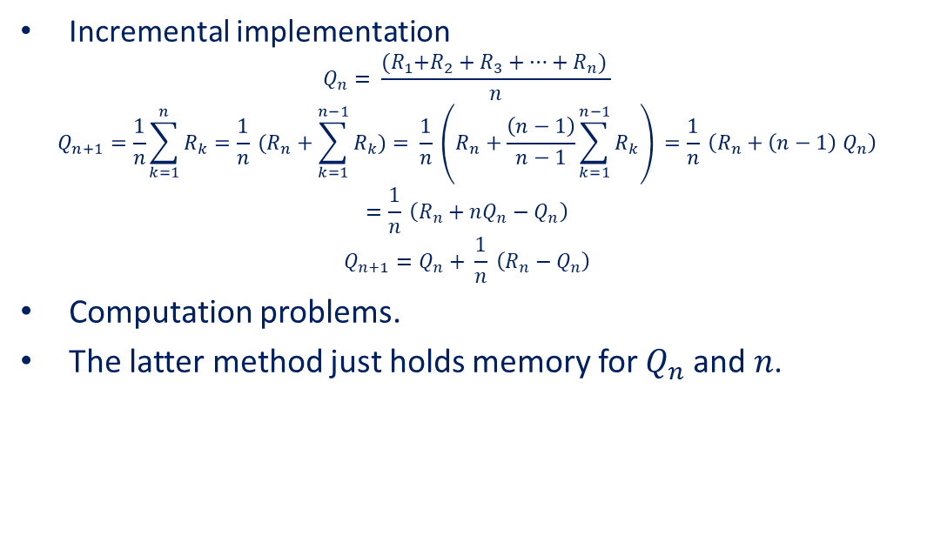
Monte Carlo approximation
Incremental implementation
$$Q_{n}= \frac{{(R}_{1}+R_{2}+R_{3}+…+R_{n}) }{n}$$
$$Q_{n+1}=\frac{1}{n}\sum_{k=1}^{n}{R_{k}}=\frac{1}{n} (R_{n}+\sum_{k=1}^{n−1}{R_{k})}= \frac{1}{n} \left(R_{n}+\frac{\left(n−1\right)}{n−1}\sum_{k=1}^{n−1}{R_{k}}\right) =\frac{1}{n} \left(R_{n}+{\left(n−1\right) Q}_{n}\right)=\frac{1}{n} \left(R_{n}+nQ_{n}−Q_{n}\right)$$
$$Q_{n+1}=Q_{n}+ \frac{1}{n} \left(R_{n}−Q_{n}\right)$$
Computation problems.
The latter method just holds memory for $Q_{n}$ and $n$.

Slide 9
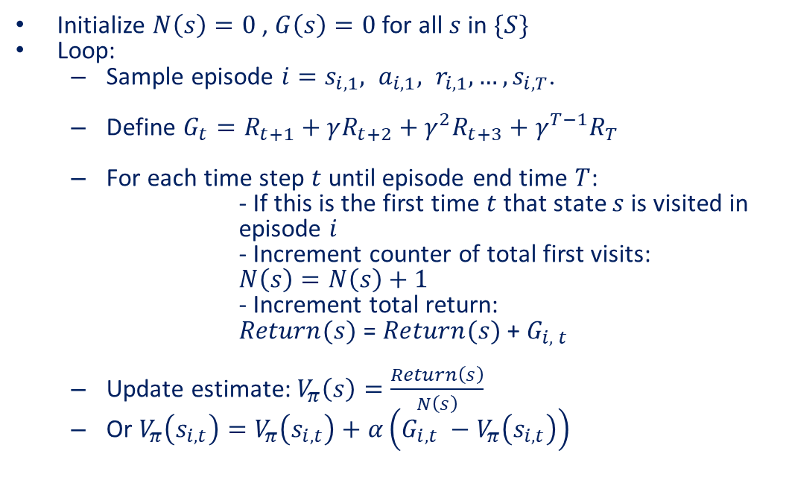
Monte Carlo approximation
Initialize $N\left(s\right)=0$ , $G\left(s\right)=0$ for all $s$in $\{S\}$
Loop:
Sample episode $i=s_{i,1}{, a}_{i,1}, r_{i,1}, …,s_{i,T}$.
Define $G_{t}=R_{t+1}+γR_{t+2}+γ^{2}R_{t+3}+γ^{T−1}R_{T}$
For each time step $t$ until episode end time $T$:
- If this is the first time $t$ that state $s$ is visited in episode $i$
- Increment counter of total first visits:
$N\left(s\right)=N\left(s\right)+1$
- Increment total return:
$Return(s)$ = $Return(s)$ + $G_{i, t}$
Update estimate: $V_{π}\left(s\right)=\frac{Return\left(s\right)}{N\left(s\right)}$
Or $V_{π}\left(s_{i, t}\right)=V_{π}\left(s_{i, t}\right)+α\left(G_{i, t} −V_{π}\left(s_{i, t}\right)\right)$

Slide 10
Monte Carlo for action values Q(s,a)
The MC method for Q(s,a)
Maintaining exploration problem.
Exploring starts assumption can solve this problem:
Assume that every state action pair has a probability to be selected as the start and in the limit of an “infinite number of episodes”.
This assumption, however, is very unlikely!

Slide 11
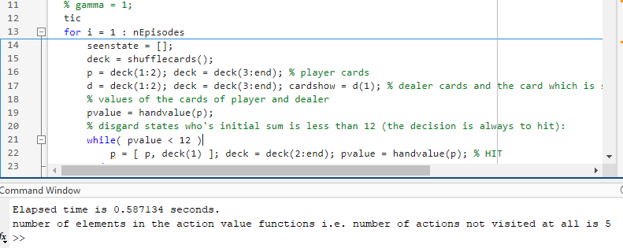
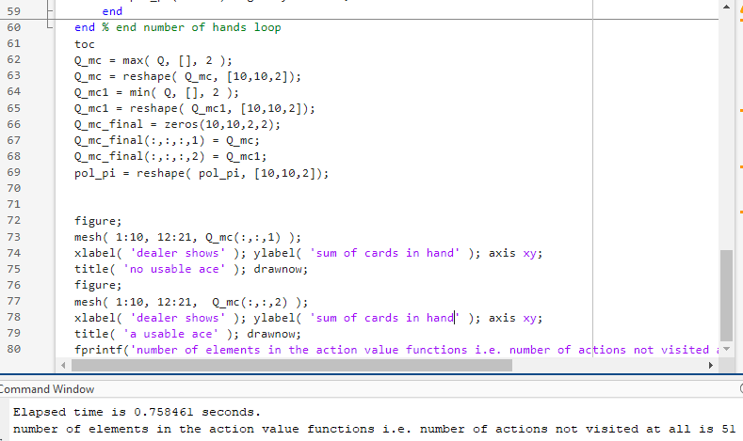
Monte Carlo for action values Q(s,a)

Slide 12
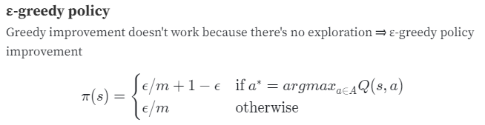
On-policy and off-policy learning
Monte Carlo control without the assumption of exploring starts:
There are two approaches to do that: on-policy and off-policy MC control
On-policy methods:

Slide 13
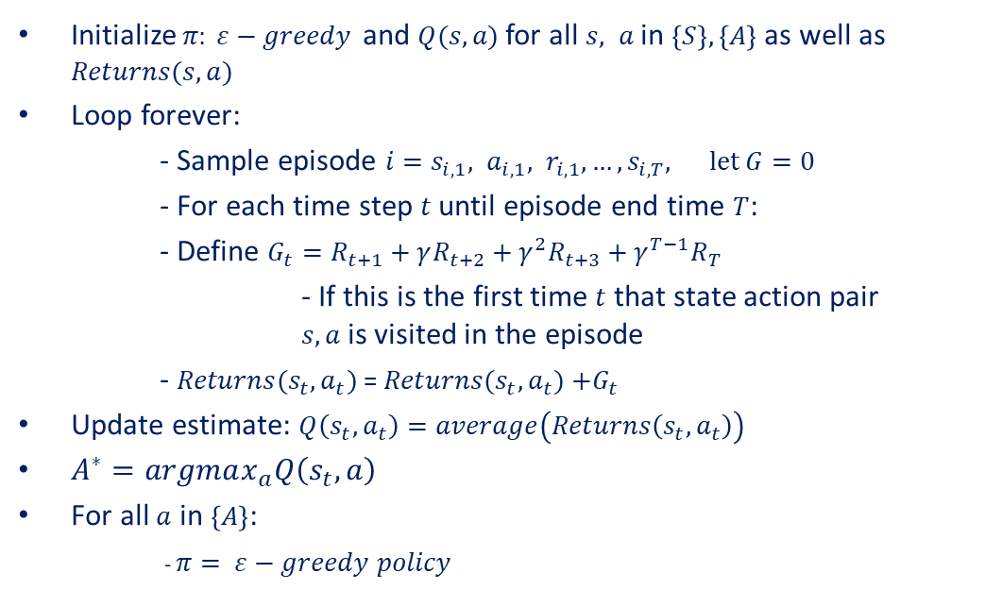
On-policy and off-policy learning
Initialize$π : ε−greedy$ and $Q(s,a)$for all $s, a$in $\left\{S\right\}, \left\{A\right\}$ as well as $Returns(s,a)$
Loop forever:
- Sample episode $i=s_{i,1}{, a}_{i,1}, r_{i,1}, …,s_{i,T}, let G=0$
- For each time step $t$ until episode end time $T$:
- Define $G_{t}=R_{t+1}+γR_{t+2}+γ^{2}R_{t+3}+γ^{T−1}R_{T}$
- If this is the first time $t$ that state action pair $s, a$ is visited in the episode
- $Returns(s_{t},a_{t})$ = $Returns(s_{t},a_{t})$ $+G_{t}$
Update estimate: $Q\left(s_{t},a_{t}\right)=average\left(Returns\left(s_{t},a_{t}\right)\right)$
$A^{∗}=argmax_{a}Q\left(s_{t},a\right)$
For all $a$ in $\left\{A\right\}$:
- $π = ε−greedy policy$

Slide 14
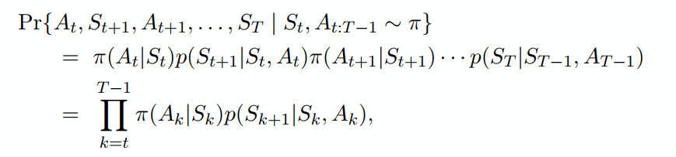
On-policy and off-policy learning
The on-policy method learns action values not for the optimal policy, but for the near optimal policy that still explores.
Off-policy method: the more straightforward approach is to use two policies:
One that is learned about (target policy).
One that is more exploratory and is used to generate behavior (behavior policy).
Probability of a trajectory to be generated (after the initial state) is:

Slide 15
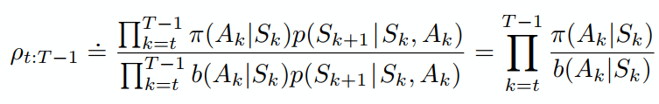
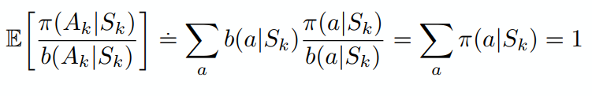


On-policy and off-policy learning
In importance sampling, each return is weighted by the relative probability of the trajectory under the two policies:
This is called “ratio” of the importance sampling.
All importance sampling ratios have expected value 1:

Slide 16
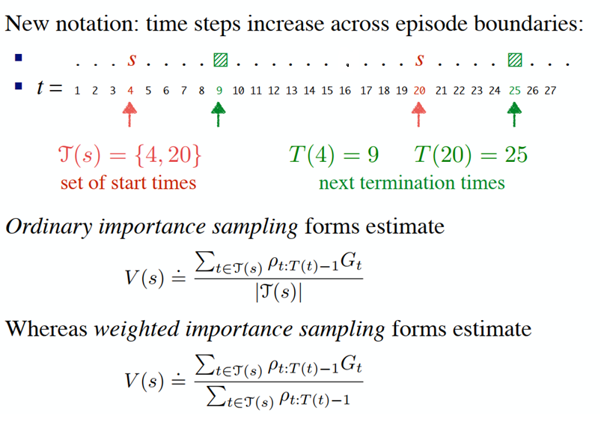
On-policy and off-policy learning

Slide 17
On-policy and off-policy learning
On-policy learning:
Direct experience.
Learn to estimate and evaluate a policy from experience obtained from following that policy.
Off-policy learning:
Learn to estimate and evaluate a policy using experience gathered from following a different policy.

Slide 18
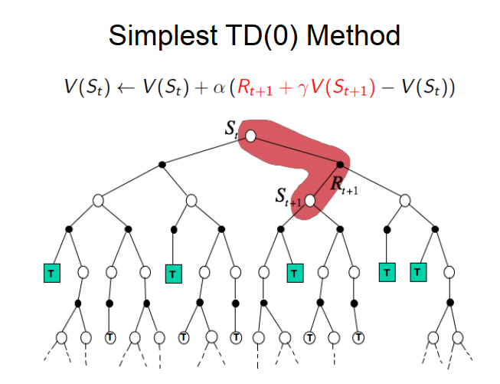
Temporal Difference learning

Slide 19
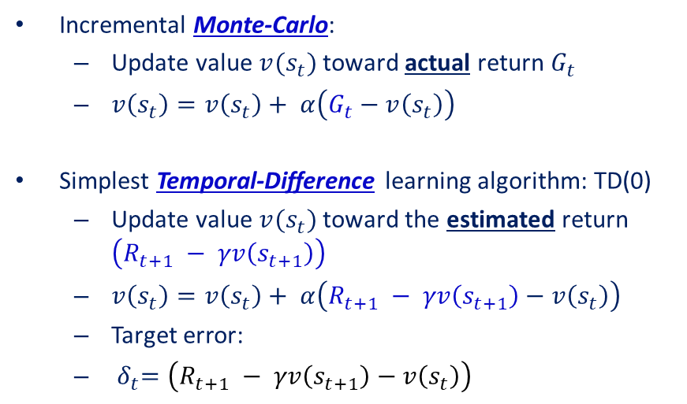
Temporal Difference learning
Incremental Monte-Carlo:
Update value $v(s_{t})$ toward actual return $G_{t}$
$v\left(s_{t}\right)=v\left(s_{t}\right)+ α\left(G_{t}−v\left(s_{t}\right)\right)$
Simplest Temporal-Difference learning algorithm: TD(0)
Update value $v(s_{t})$ toward the estimated return $\left(R_{t+1} − γv\left(s_{t+1}\right)\right)$
$v\left(s_{t}\right)=v\left(s_{t}\right)+ α\left(R_{t+1} − γv\left(s_{t+1}\right)−v\left(s_{t}\right)\right)$
Target error:
${ δ}_{t}=\left(R_{t+1} − γv\left(s_{t+1}\right)−v\left(s_{t}\right)\right)$

Slide 20
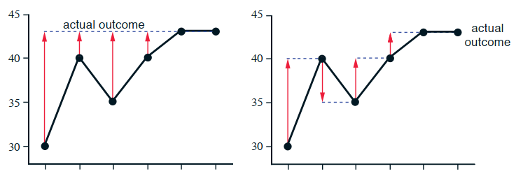
Temporal Difference learning

Slide 21

Temporal Difference learning
TD Methods Bootstrap and Sample
Bootstrapping: updates involve an estimate
MC doesn’t bootstrap: It uses the actual return G in:
$v\left(s_{t}\right)=v\left(s_{t}\right)+ α\left(G_{t}−v\left(s_{t}\right)\right)$
DP bootstraps
TD bootstraps
Sampling: updates don’t involve an expected value
MC samples
DP doesn’t sample
TD samples: It uses the estimate of the return $R_{t+1} − γv\left(s_{t+1}\right)$ in:
$v\left(s_{t}\right)+ α\left(R_{t+1} − γv\left(s_{t+1}\right)−v\left(s_{t}\right)\right)$

Slide 22
Advantages of TD learning
TD methods do not require a transition model, only experience.
Learning is possible before knowing the final outcome (suitable for online learning).
TD methods require less memory and computation compared to MC.
TD methods can learn from incomplete sequences, enabling them to be used in the continues or non-episodic task.
Both MC and TD converge (under certain assumptions), but which one is faster?
Notes:
At the current time this is an open question in the sense that no one has been able to prove mathematically. In fact, it is not even clear what is the most appropriate formal way to phrase this question! Practically, TD is faster than MC.

Slide 23
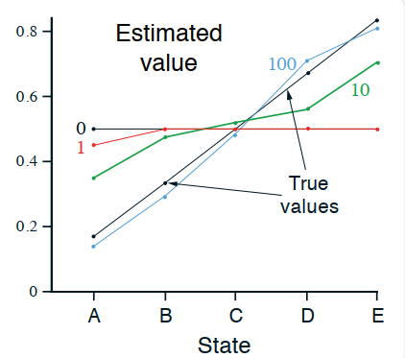
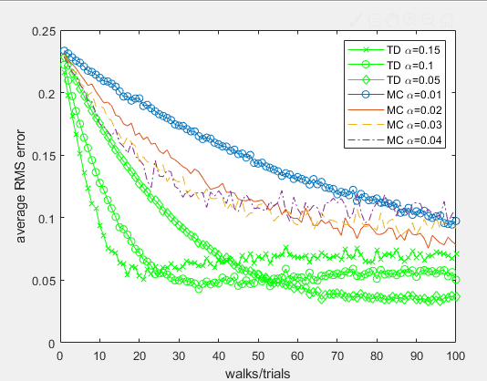

Simulation results
TD is faster!
Random walk problem:

Slide 24
Thank you! Q&A!

